Slide 1
Lecture 3 Roots of Nonlinear Equations Bisection Method
CSE 235
Numerical Methods
Md. Monarul Islam Mithu
Lecturer, Daffodil International University

Slide 2
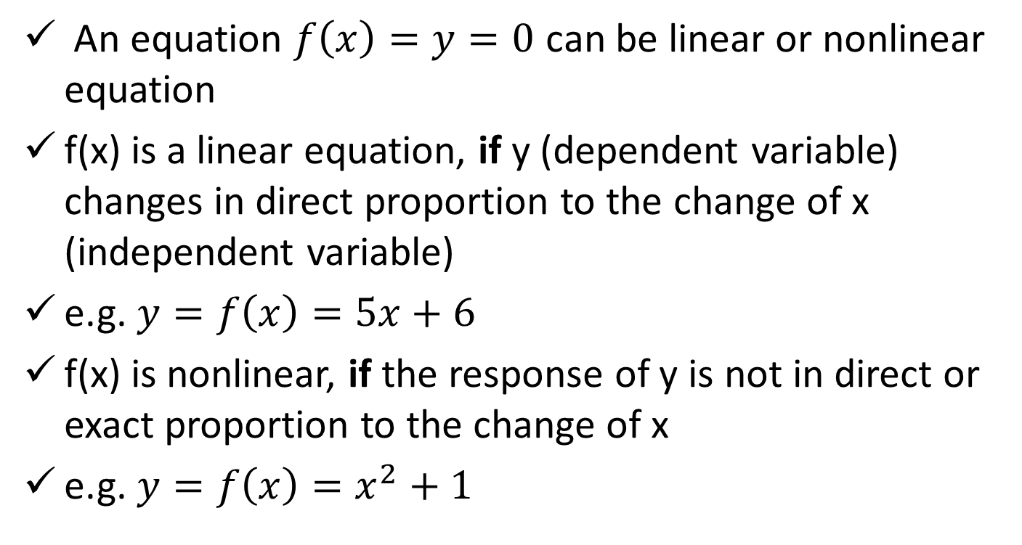
Linear vs. Nonlinear Equation

Slide 3
Non-linear equation
Nonlinear equations can contain polynomials with quadratic, cubic, and higher order terms.
They can also contain rational, exponential, and logarithmic functions.

Slide 4
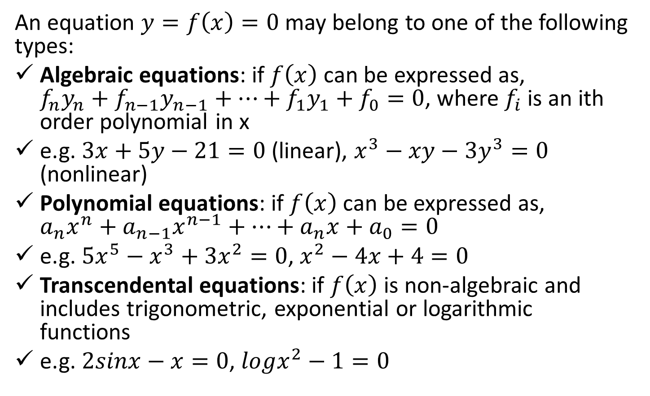
Types of Equations

Slide 5
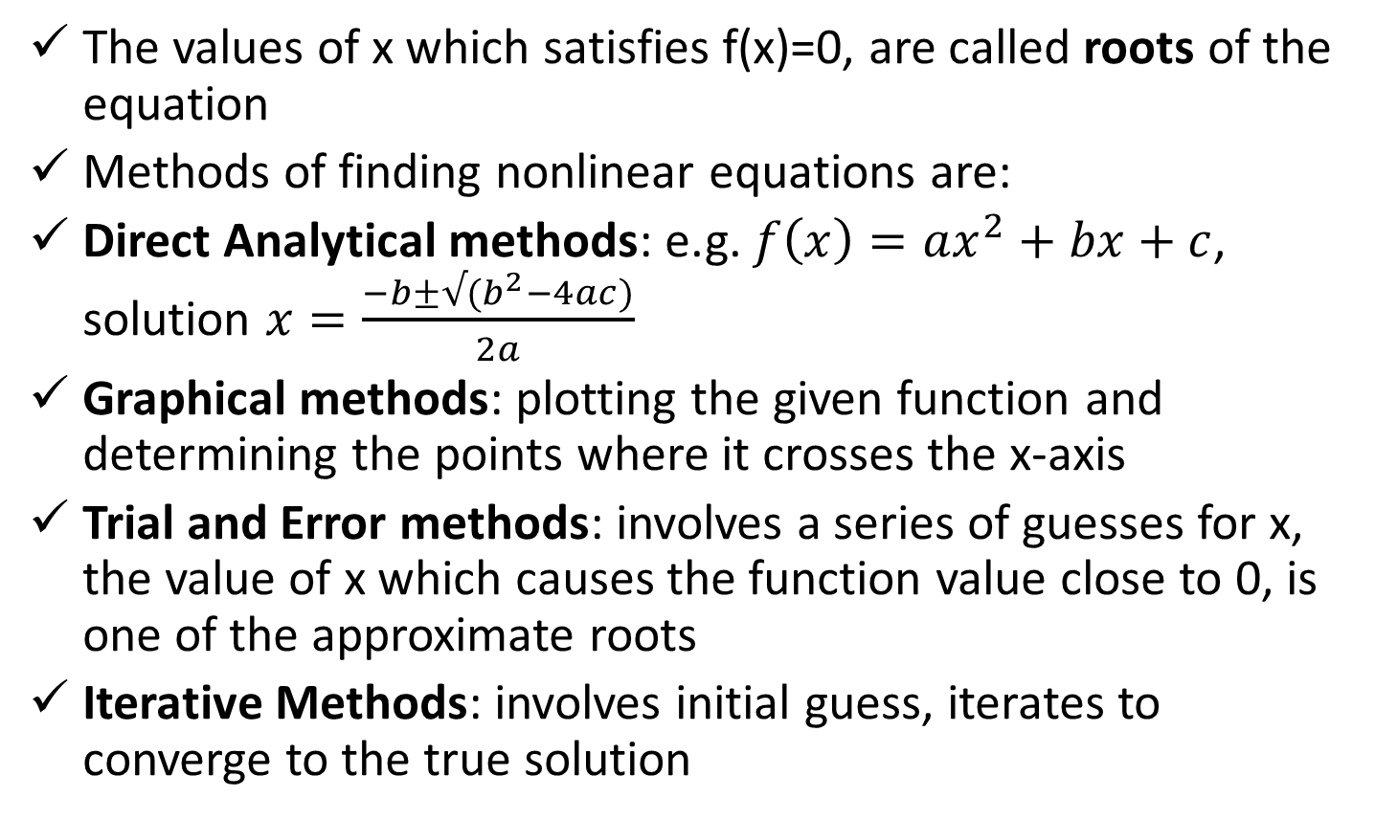
Methods of finding roots of nonlinear equations

Slide 6
Iterative Methods
Can be grouped into two categories:
Bracketing methods (Interpolation methods): start with two initial guesses that bracket the root, then systematically reduce the width of bracket until the solution is found; the following 2 methods will be discussed:
Bisection Method
False Position Method
Open end methods (Extrapolation methods): use a single starting value (or two values which not necessarily bracket the root); will be discussed:
Newton-Raphson Method
Secant Method

Slide 7
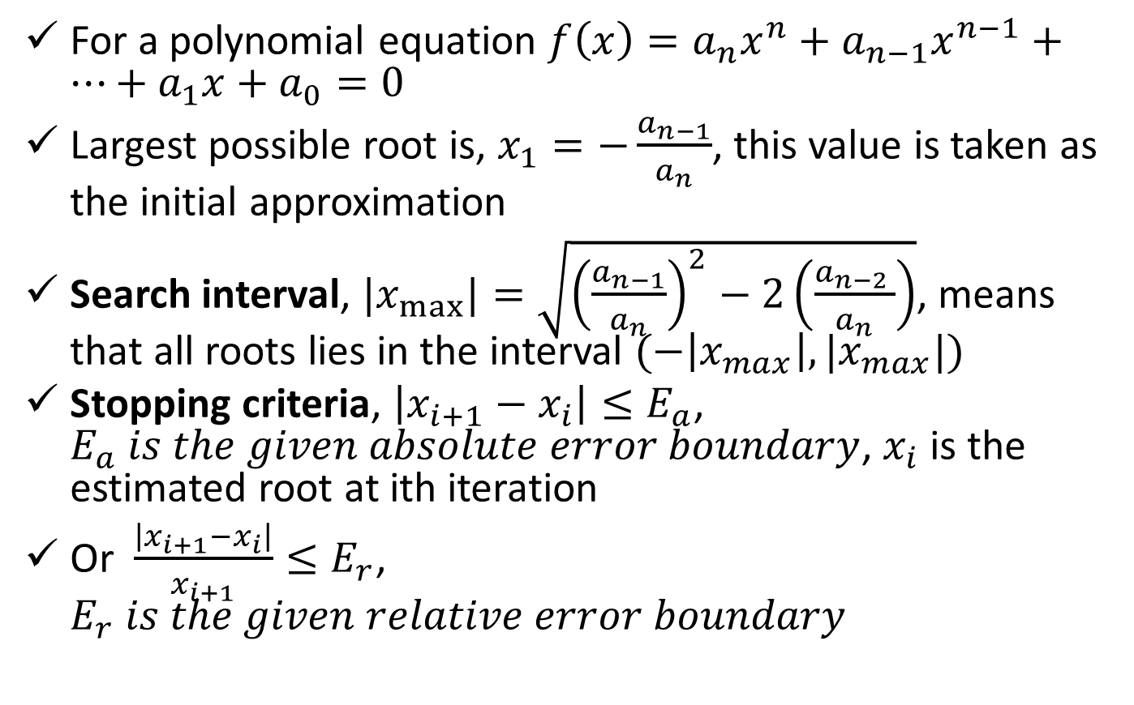
Starting and Stopping an Iterative Process

Slide 8
Bisection Method
f(x)
b
a
x
f(x)=0
f(x) is real and continuous in the interval a<x<b and f(a).f(b)<0
There is at least one real root in the interval [a, b]

Slide 9
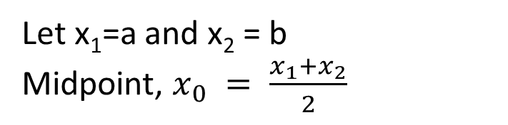
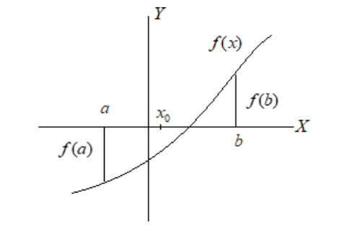
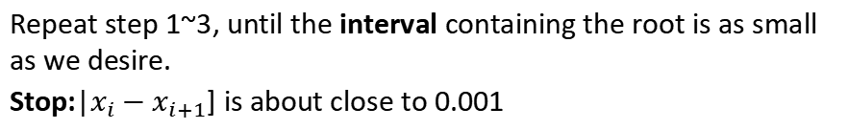
There exists 3 following conditions:
If f(x₀)=0, x₀ is the root
If f(x₀).f(a)<0, root lies [a, b=x₀]
If f(x₀).f(b)<0, root lies in [a=x₀, b]
Limitations:
Slow to converge
Requires more iteration

Slide 10
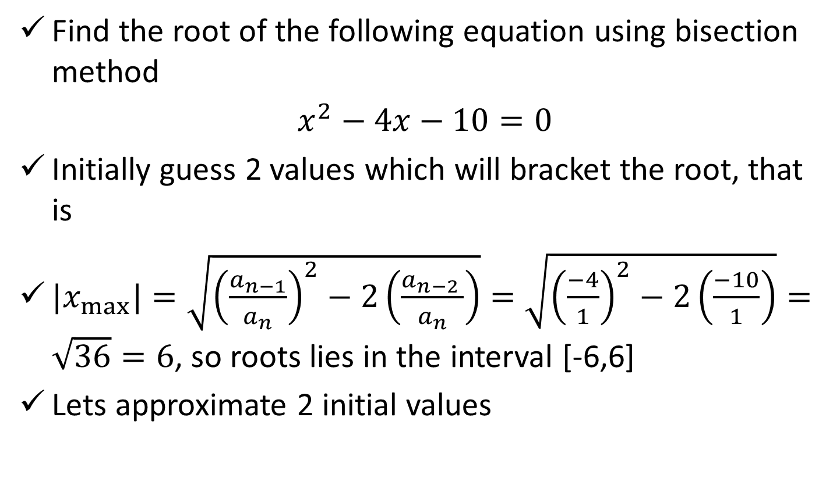
Bisection Method (math1)
Roots lie here
x
-6
-5
-4
-3
-2
-1
0
1
2
3
4
5
6
f(x)
50
35
22
11
2
-4
-10
-13
-14
-13
-10
-5
2

Slide 11
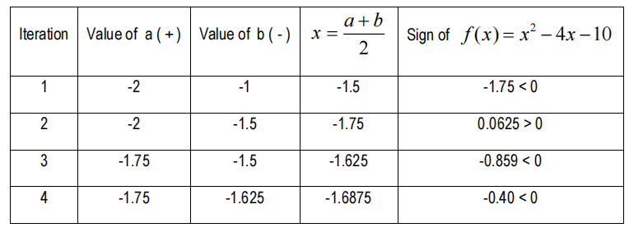

Slide 12
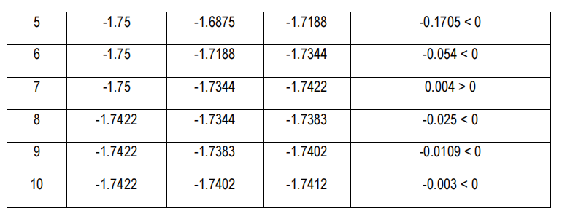
The approximate root of the given equation is = −1.7412 because f(-1.7412)=-0.003 that is close to zero.

Slide 13
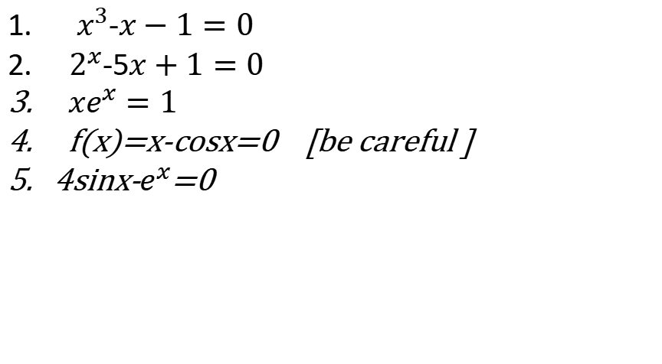
Do It Yourself!!!

Slide 14
Thank you

